Slide 1
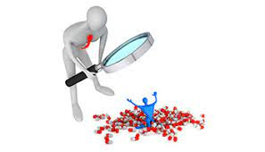
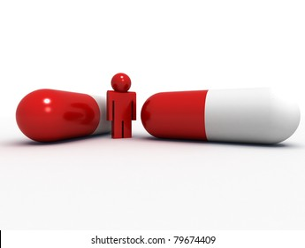
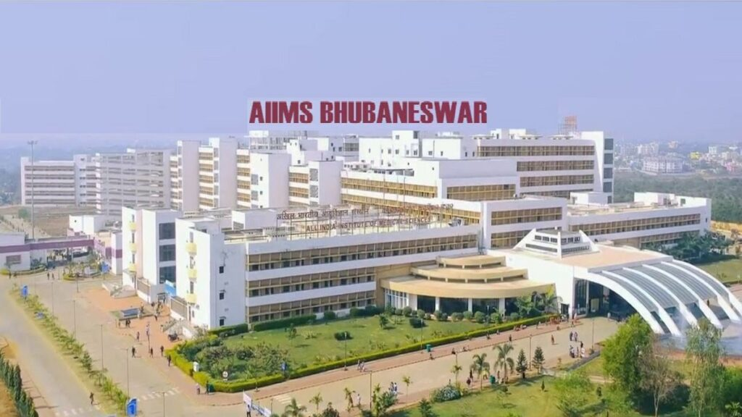
Adverse drug reaction Reporting
AND
MONITORING
Dr Bikash Ranjan Meher
Additional Professor
AIIMS,Bhubaneshwar

Slide 2

Introduction
Drug therapy is an integral component of heath care delivery system
Drug therapy problem (DTP) is any unwanted incident related to medication therapy
Categorized into seven major classes
Unnecessary drug therapy, need additional drug therapy,wrong drug therapy, dosage too low, dosage too high, adverse drug reaction (ADR) and non-compliance

Slide 3
Adverse Drug Reaction
Adverse Event
Unintended noxious response to a drug which occurs at doses normally used in man for prophylaxis, diagnosis, or therapy of disease, or for the modification of physiological function
Causal relationship
Untoward medical occurrence that may be present during treatment with a medicine
Not necessarily have causal relationship

Slide 4
Types of Adverse Drug Reactions
Type A (Augmented)
Type B (Bizarre)
Type C (Chronic)
Type D (Delayed)
Type E (End of use)
Type F (Failure of therapy)

Slide 5
Type A reactions
Augmented but normal pharmacological effects of medicines
Predictable
Dose dependent
Extension of pharmacologic effects
Treated by reducing the dose or withholding the medicine
Examples
Hypoglycaemia with sulfonylurea

Slide 6
Type B reactions
Bizarre with no relation to dose or pharmacological action of the medicine
Unpredictable
Uncommon but are often severe and cause high mortality
Treated by stopping the medicine and avoiding it in the future
Examples
Anaphylactic reaction to penicillin administration
Aplastic anaemia caused by chloramphenicol

Slide 7
SERIOUS adr
Any untoward medical occurrence that any dose
Results in death
Is life threatening
Requires inpatient hospitalisation or prolongation of hospitalisation
Result in persistent disability/incapacity
Causes congenital anomaly/birth defect

Slide 8
Modified hartwig’s criteria
Mild (Level 1-2)
Moderate( Level 3-4)
Severe ( >5)
Severity of ADR

Slide 9
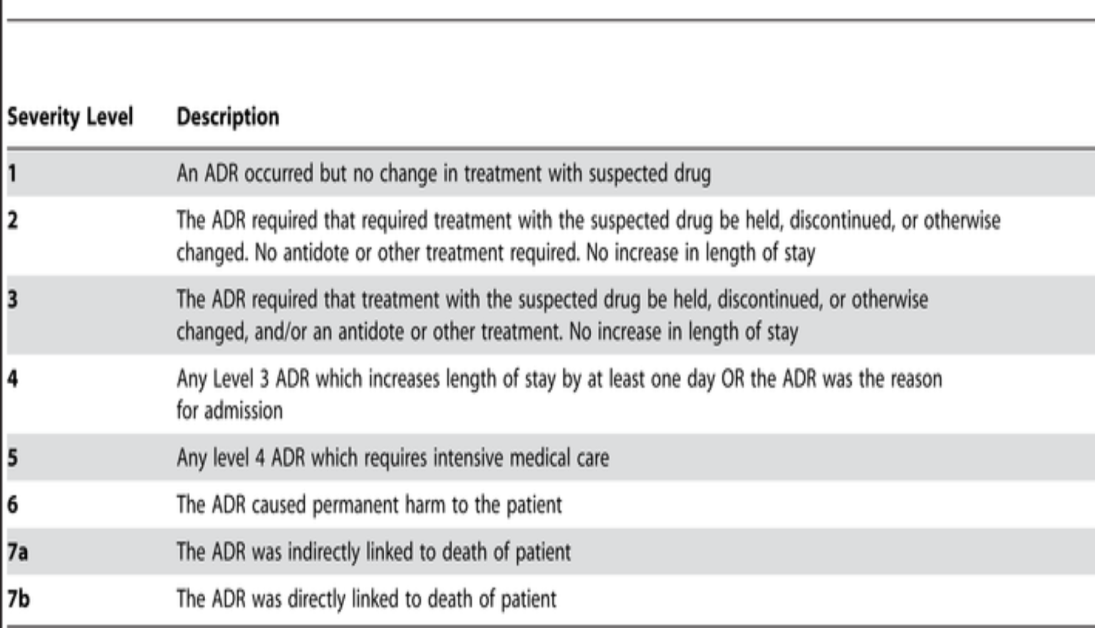
Modified hartwig’s criteria

Slide 10


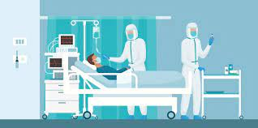

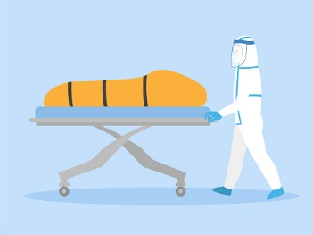


ADR is a big problem?

Slide 11
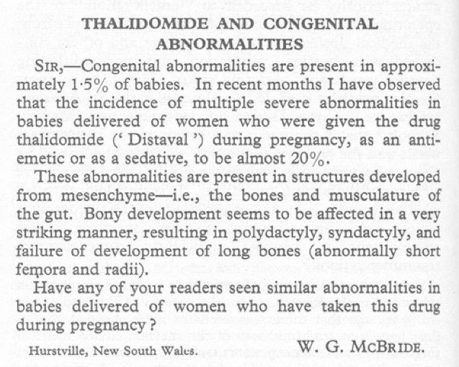
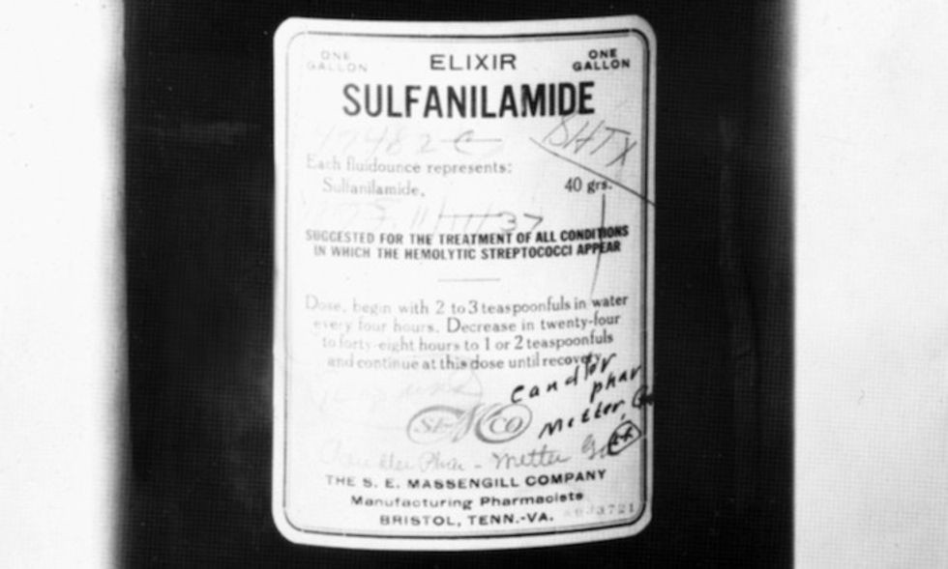


NOTEWORTHY CASES OF Adrs in medical history

Slide 12
Drugs recalled by REGULATORY AGENCIES
Drug
Valdecoxib
Cisapride
Rofecoxib
Terfenadine
Troglitazone
Efalizumab
Sibutramine Trovafloxacin Tolcapone Phenylpropanolamine

Slide 13
Can ADR be prevented?
Yes
Timely recognition of symptoms
Required knowledge and skill
Appropriate management
Reporting

Slide 14

Adr Monitoring
Process of continuous monitoring of undesirable effect suspected to be associated with use of medicinal products

Slide 15

Objectives of ADR monitoring
To detect the nature and frequency of ADRs
To identify the risk factors that predispose, induce or influence the development ,incidence, severity of adverse reactions in population

Slide 16
Benefits of ADR monitoring
Provides information about quality and safety of pharmaceutical products
Assess the safety of drug therapies, especially recently approved drugs
Helps in measuring ADR incidence
Prevents the predictable adverse effects

Slide 17
Benefits of ADR monitoring
Initiates risk-management plans
Creates awareness regarding ADRs
Assist drug regulatory authority to initiate appropriate action to minimize the risk

Slide 18
Data Source
Solicited
report
Unsolicited report

Slide 19
Solicited reports
Clinical trials
Non interventional studies
Periodic safety update report
Registries
ADR monitoring schemes in hospital

Slide 20
Unsolicited report
Spontaneous reporting by healthcare professionals
Literature reports
Reports on internet or digital media

Slide 21
Steps of ADR monitoring
Identifying ADR
Assessing causality between drug and suspected reaction
Reporting serious ADRs to PV center / regulatory authority
Documentation of ADR in patient’s medical record

Slide 22

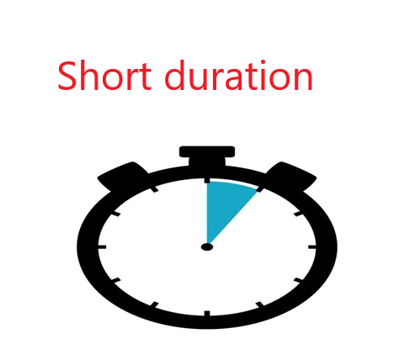
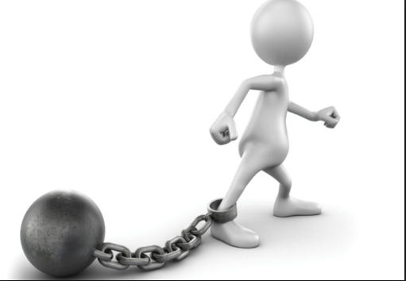
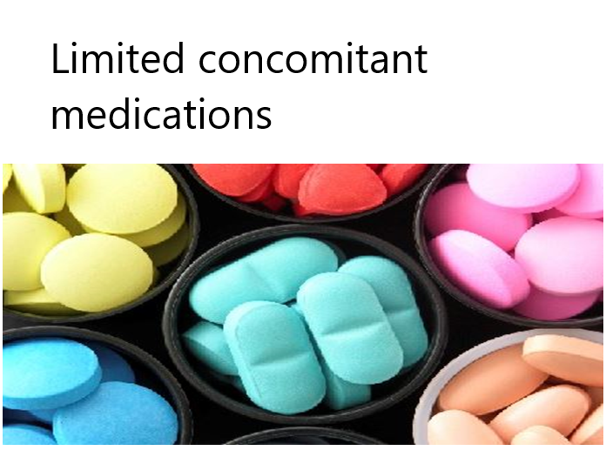
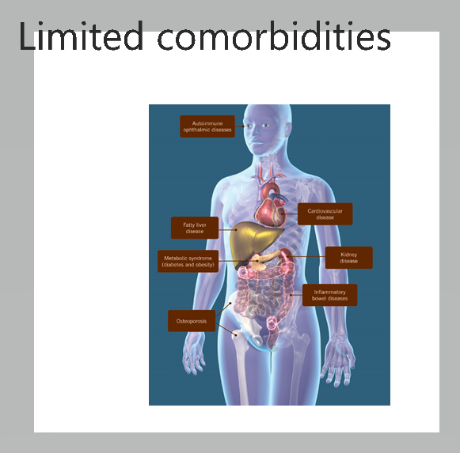
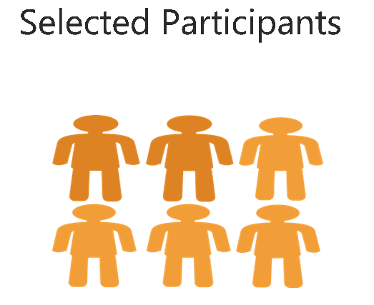
Limitations of Premarketing clinical trials

Slide 23
Post marketing surveillance
Anecdotal reporting
Intensive monitoring studies
Spontaneous reporting system
Prospective studies
Retrospective studies
Meta-analysis
Registries

Slide 24
Causality assessment
Whether or not a drug is responsible for an adverse reaction
It is required to be done
During clinical research
When report is initially submitted to pharmaceutical company or regulatory authority
At the time of signal generation
At the time of writing PSUR

Slide 25
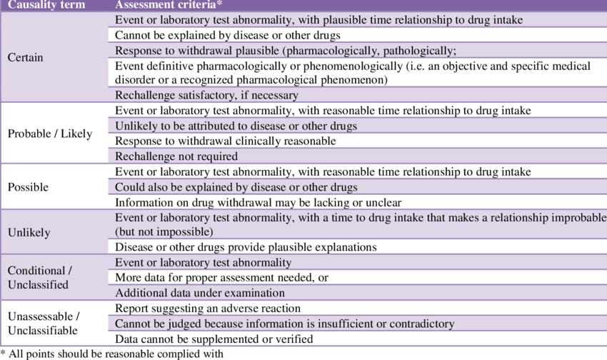
WHO-UMC CAUSALITY CRITERIA

Slide 26
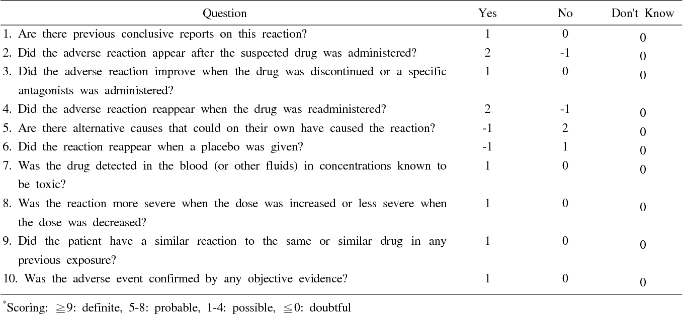
Naranjo’s algorithm for causality assessment

Slide 27

Pharmacovigilance
Pharmacovigilance refers to the science and activities relating to the detection, assessment, understanding, and prevention of adverse effects and other drug-related safety problems

Slide 28

To improve patient care and safety in relation to use of medicines
To improve public health and safety in relation to use of medicines
To contribute to the assessment of benefit, risk and effectiveness of medicines, encouraging their safe and rational use
To promote usnderstanding,education and training in pharmacovigilance and its effective communication to health professionals and public

Slide 29
Humanitarian concern
Need of Pharmacovigilance
Promoting rational
use of medicines
and adherence
High cost
of ADR
Ensuring
public confidence
Safe use of medicines

Slide 30
Pharmacovigilance programme of India
Launched on 14 July 2010
Funded by the union Government
NCC shifted to IPC,Ghaziabad on 15 April,2011

Slide 31
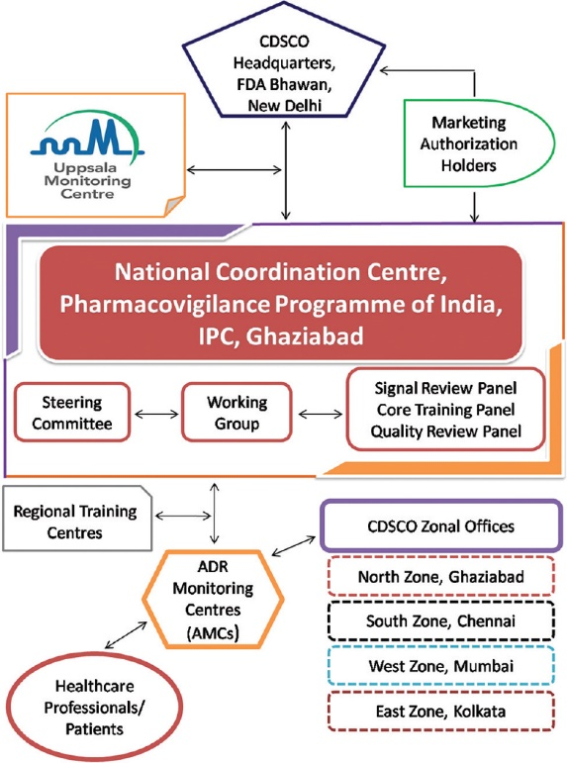
Organogram of PvPI

Slide 32

To develop robust pharmacovigilance system in the country
To enrol all medical collages
To encourage all health care professionals
Collection of case report
To expand pharmacovigilance program to all hospitals
To develop and implement e reporting
To develop reporting culture among health care professionals
To make ADR reporting mandatory for health care professionals

Slide 33
What is an ICSR?
Individual Case Safety Report is a document in a specific format for the reporting of one or several suspected adverse reactions to a medicinal product that occur in a single patient at a specific point of time

Slide 34
It should contain the following 4 basic elements to be considered valid
An identifiable patient/subject
An identifiable reporter
A suspect drug or biological product
An adverse event

Slide 35

Timeline of ICSR?
Serious ADR -Within 15 calendar days
Non serious ADR- Within 90 calendar days

Slide 36
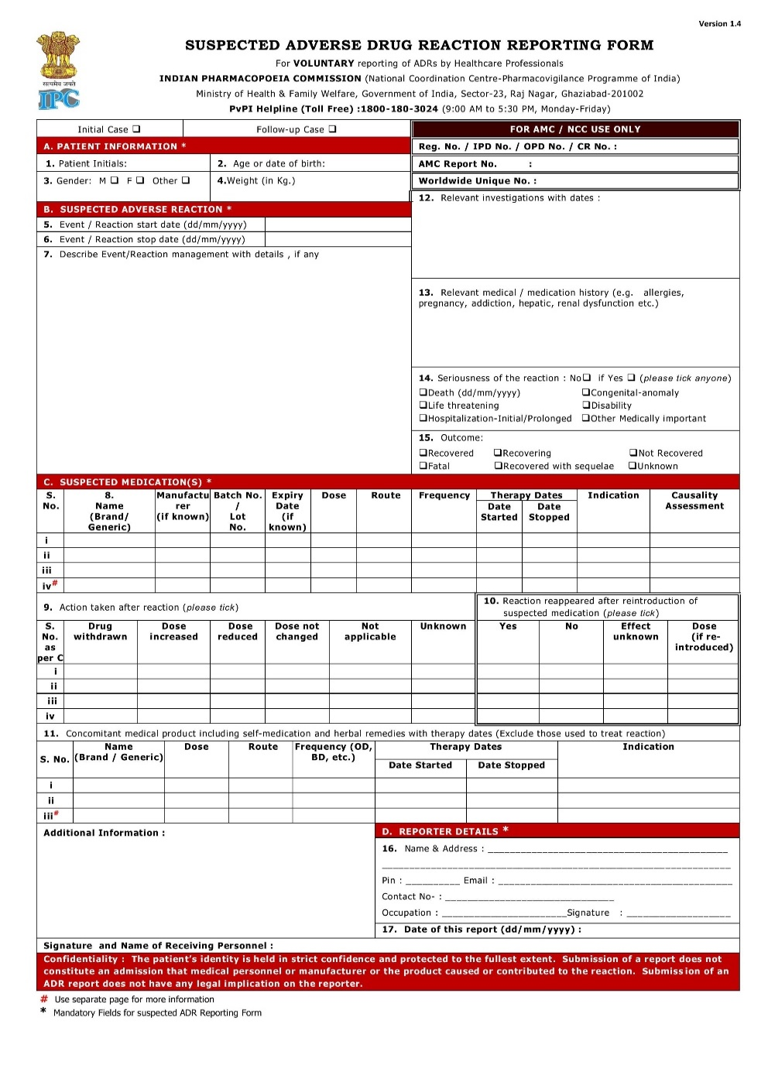
Suspected adverse drug reaction
reporting form

Slide 37

What to report?
Who can report ?
Serious adverse drug reactions
Non-serious, known or unknown,
frequent or rare adverse drug reactions
due to Medicines, Vaccines and Herbal products.
All healthcare professionals
(Clinicians, Dentists, Pharmacists and Nurses)
Where to report ?
Nearest AMC or directly to NCC
Call on Helpline (Toll Free) 1800 180 3024 to report ADRs
Directly mail this filled form to pvpi@ipcindia.net or vpi.ipcindia@gmail.com

Slide 38
Spontaneous reporting
Reporting of suspected ADR by health care professionals
Voluntary, Unpaid
Most common method of reporting
Underreporting

Slide 39
Periodic safety update report
A pharmacovigilance document intended to provide an update of the worldwide safety experience of a medicinal product to regulatory authorities at defined time points post-authorisation

Slide 40
Objectives
To present a comprehensive and critical analysis of the risk-benefit balance of the product taking into account new or emerging safety information in the context of cumulative information on risk and benefits
To ascertain whether further investigations need to be carried out and whether changes should be made to the product information or marketing authorisation

Slide 41
Frequency
Six monthly for first two years
Yearly for next three years
As and when asked by regulatory authority

Slide 42
Lets promote the safe use of medicines
Thank you

